Slide 1
Explainability

Slide 2
Explainability
Explainability is an important aspect for building trust in a neural network.
If you can't explain why your algorithm performs as it does, then at the very least there is concern for overfitting, or fitting on irrelevant features having and association with the outcome.
Below we'll show a very basic version of explainability. Let's redo our convnet example, now on the GPU.

Slide 3

Example, using our previous convnet
Predicting an earring for this subject

Slide 4
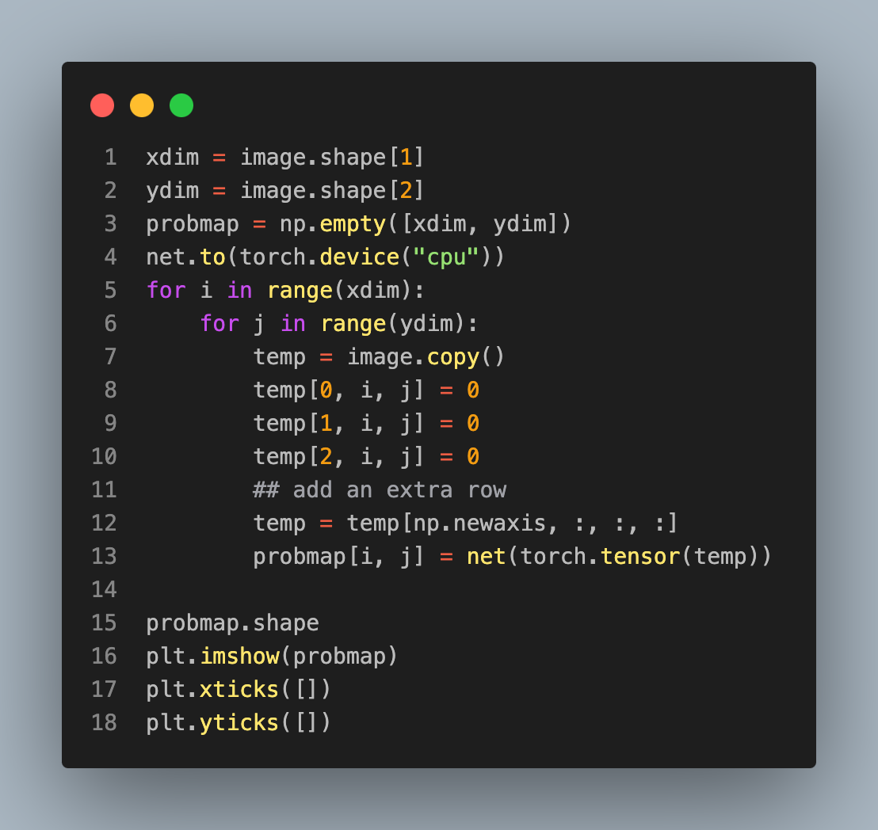

Looking at the change in prediction

Slide 6
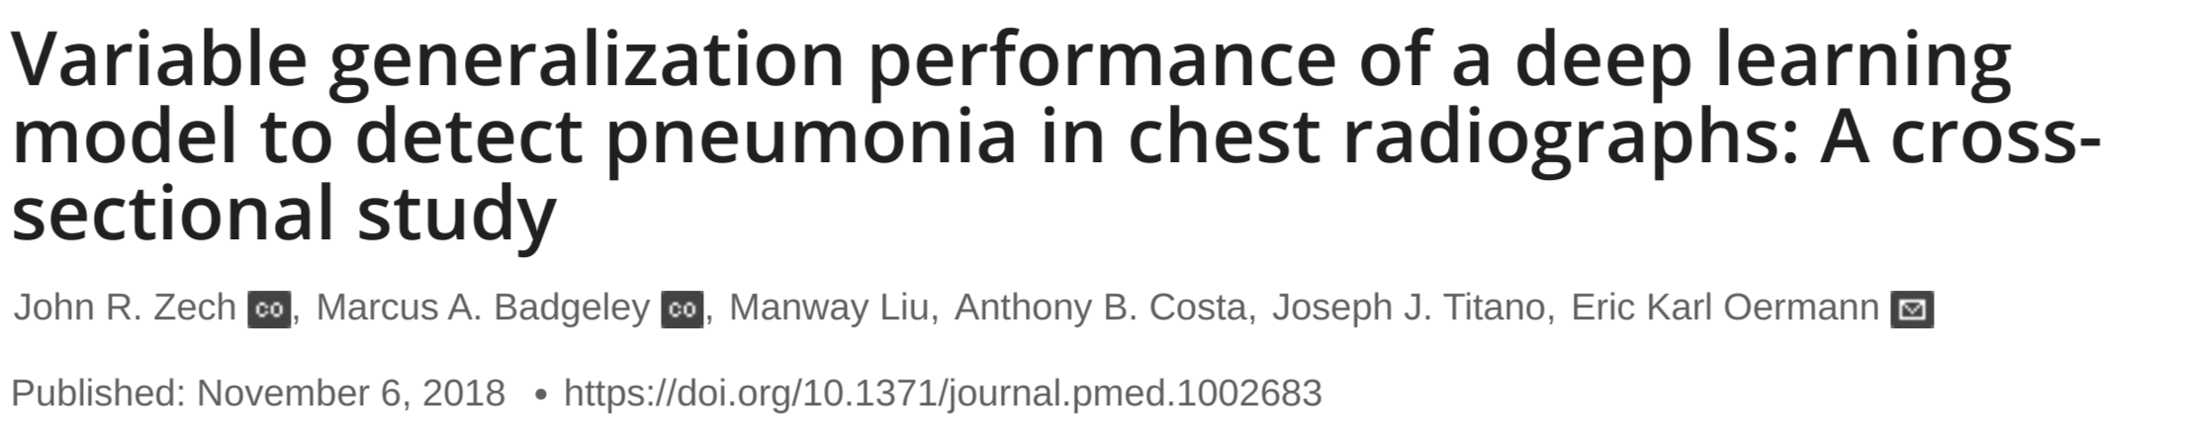
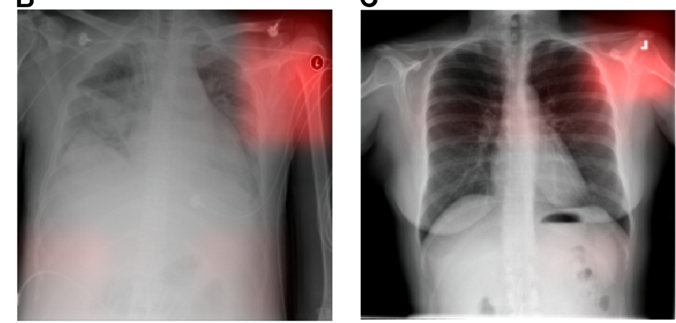
“... we note that the CNN has learned to detect a metal token that radiology technicians place on the patient in the corner of the image field of view at the time they capture the image ...”

Slide 7
